Slide 1

ONLINE PLANT NURSERY APPLICATION
Presented by (Group-5):
1) Amajala Sri Ram Pavan
2) Jittiga Sri Harsha
3) Kakileti Mukunda Naga Saipriya
BATCH:
CAMP JR-30

Slide 2
CONTENTS
Problem Statement
Technologies
Modules
Program Structure in Eclipse
POJO Classes
Model of a POJO Class
Service Classes
Model of a Service & Control Class
Repository Class
Model of a Repository Class
Implementation in Swagger UI
Benifits
Conclusion

Slide 3
PROBLEM STATEMENT
To Create an Application for Online Plant Nursery Application
Customer should be able to view the list of Plants , Seeds , Planters.
Customer should be able to buy order desired plants, seeds, planters.
Admin should be able to perform below operations:
Plants Management
Seeds Management
Planters Management
Customer Management

Slide 4
TOOLS/Technologies
Java 8
Spring Boot
Spring Security
PostgreSQL
Maven
Swagger UI

Slide 5


Java 8:
JAVA 8 is a major feature release of JAVA programming language development.
With the Java 8 release, Java provided supports for functional programming, new JavaScript engine, new APIs for date time manipulation, new streaming API, etc.
Developed using Java, the Eclipse platform can be used to develop rich client applications, integrated development environments and other tools.
Eclipse is designed to handle large development projects.

Slide 6
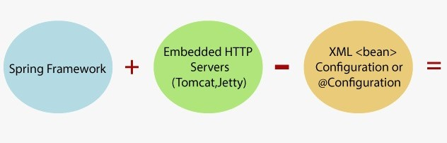

Spring Boot:
In short, Spring Boot is the combination of Spring Framework and Embedded Servers.In Spring Boot, there is no requirement for XML configuration.
It uses convention over configuration software design paradigm that means it decreases the effort of the developer.
We can use Spring STS IDE or Spring Initializer to develop Spring Boot Java applications.

Slide 7
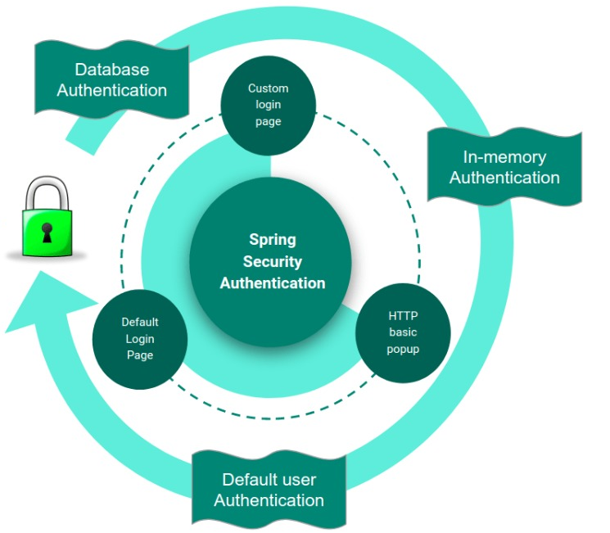
Spring Security:
Spring Security is a powerful and highly customizable authentication and access-control framework.
It is the de-facto standard for securing Spring-based applications.
Spring Security is a framework that focuses on providing both authentication and authorization to Java applications.

Slide 8

PostgreSQL:
PostgreSQL is a powerful, open source object-relational database system.
It has more than 15 years of active development and a proven architecture that has earned it a strong reputation for reliability, data integrity, and correctness.
PostgreSQL runs on all major operating systems, including Linux, UNIX (AIX, BSD, HP-UX, SGI IRIX, Mac OS X, Solaris, Tru64), and Windows.

Slide 9
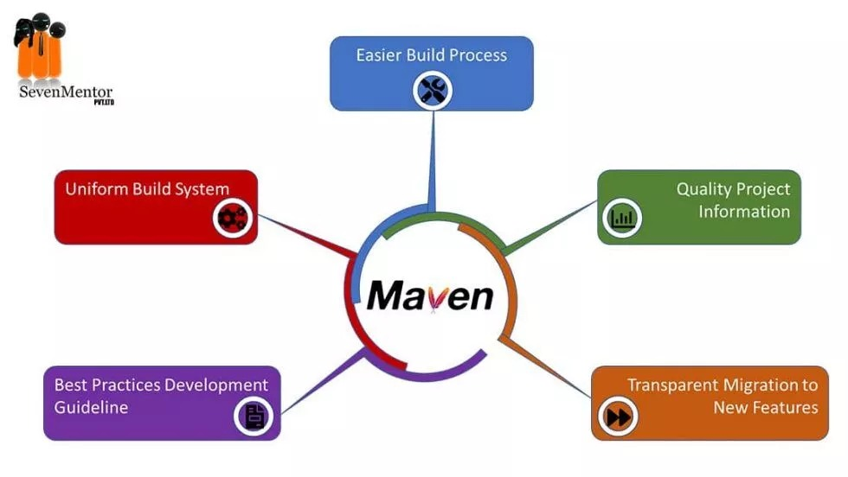
Maven:
Maven is a project management and comprehension tool that provides developers a complete build lifecycle framework.
Development team can automate the project's build infrastructure in almost no time as Maven uses a standard directory layout and a default build lifecycle.

Slide 10

Swagger UI:
The Swagger framework allows developers to create interactive, machine and human-readable API documentation.
API specifications typically include information such as supported operations, parameters and outputs, authorization requirements, available endpoints and licenses needed.

Slide 11
MODULES
Login Module
Customer Module
Plants Management Module
Planters
Management Module
OrderBooking Management module
Seeds Management Module

Slide 12
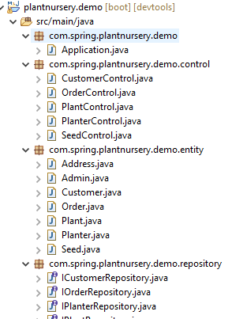
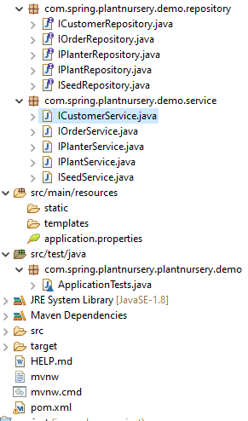
Project Structure in Eclipse

Slide 13
Plant
-plantId:Integer -plantHeight:Integer -plantSpread:String -commonName:String -bloomTime:String -medicinalOrCulinaryUse:String -difficultyLevel:String -temperature:String -typeOfPlant:String -plantDescription:String -plantStock:Integer -plantCost:double
Admin
-adminid:int -adminUsername:String -adminPassword:String
Address
-addressId:Integer -houseNo:String -colony:String -city :String -state:String -pincode:int
POJO CLASSES
Customer
-customerId:Integer -customerName:String -customerEmail:String -username:String -password:String -address:Address
Seed
-seedId:Integer -commonName:String -bloomTime:String -watering:String -difficultyLevel:String -temperature:String -typeOfSeeds:String -seedsDescription:String -seedStock:Integer -seedsCost:double -seedsPerPacket:Integer
Planter
-planterId:Integer -planterHeight:float -planterCapacity:int -drinageHoles:int -planterColor:int -planterShape:String -planterStock:int -planterCost:int -plants:Plants -seeds:Seeds
Order
-bookingOrderId:Integer -orderDate:LocalDate -transactionMode:String -quantity:int -totalCost:double -planters:Planters

Slide 14
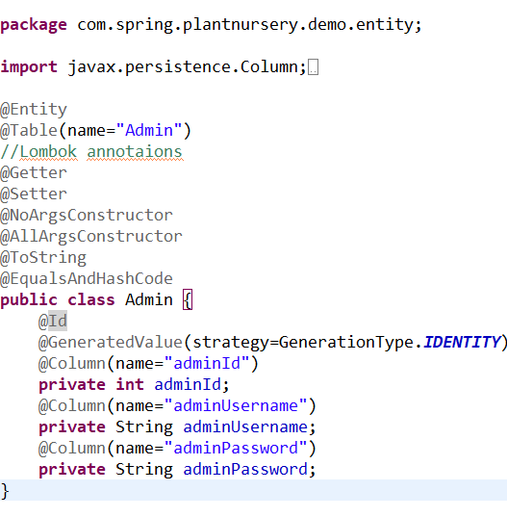
Model of a POJO Class in Eclipse:

Slide 15
IPlantService
+addPlant(Plant plant):Plant +updatePlant(Plant plant):Plant +deletePlant(Plant plant):Plant +viewPlant(int plantid):Plant +viewPlant(string commonName):Plant +viewAllPlants():List<plant> +viewAllPlants(String typeOfPlant):List<Plant>
ICustomerService
addCustomer(Customer customer): Customer updateCustomer(Customer tenant): Customer deleteCustomer(Customer tenant): Customer viewCustomer(int customerId):Customer ViewAllCustomer():List<Customer> validateCustomer(String userName,String password):
SERVICE CLASSES
ISeedService
+addSeed( Seed seed):Seed +updateSeed(Seed seed ):Seed +deleteSeed(Seed seed):Seed +viewSeed(int seedid):Seed +viewSeed(String common Name):Seed +viewAllSeeds():List<Seed> +viewSeed(String typeOfSeed):List<Seed>
IPlanterService
+addPlanter(Planter Planter):Planter +updatePlanter(Planter planter):Planter +deletePlanter(Planter planter):Planter +viewPlanter(int planterid):Planter +viewPlanter(String planterShape):Planter +viewAllPlanters():List<Planter> +viewAllPlanters(double min Cost, double maxCost):List<Planter>
IOrderService
+addOrder(Order order):Order +updateOrder(Order order|:Order +deleteOrder(int orderId):Order +viewOrder(int orderId):Order +viewAllOrder():List<Order>

Slide 16
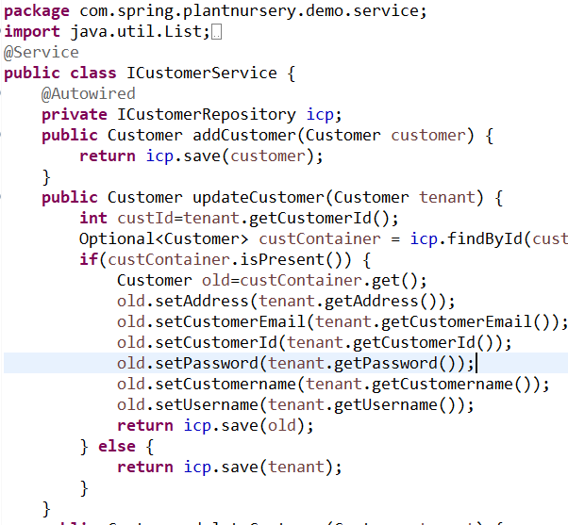
Model of a Service Class in Eclipse:

Slide 17
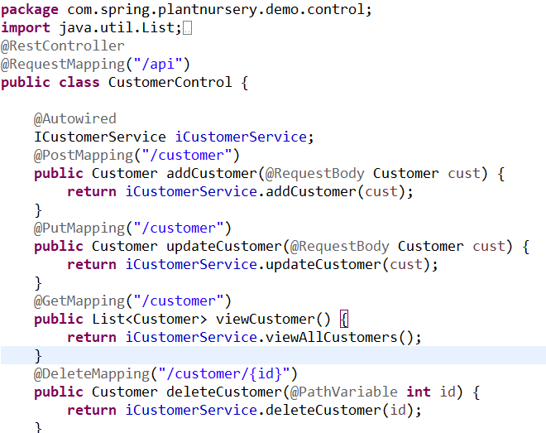
Model of a Control class in Eclipse:

Slide 18
IPlantRepository
+addPlant(Plant plant):Plant +updatePlant(Plant plant):Plant +deletePlant(Plant plant):Plant +viewPlant(int plantid):Plant +viewPlant(string commonName):Plant +viewAllPlants():List<plant> +viewAllPlants(String typeOfPlant):List<Plant>
ICustomerRepository
addCustomer(Customer customer): Customer updateCustomer(Customer tenant): Customer deleteCustomer(Customer tenant): Customer viewCustomer(int customerId):Customer ViewAllCustomer():List<Customer> validateCustomer(String userName,String password);
REPOSITORY CLASSES
ISeedRepository
+addSeed(Seed seed): Seed +updateSeed(Seed seed):Seed +deleteSeed(Seed seed):Seed +viewSeed(int seedId):Seed +viewSeed(String commonName):Seed +viewAllSeeds():List<Seed> +viewAllSeeds(String typeOfSeeds):List<Seed>
IPlanterRepository
+addPlanter(Planter Planter):Planter +updatePlanter(Planter planter):Planter +deletePlanter(Planter planter):Planter +viewPlanter(int planterid):Planter +viewPlanter(String planterShape):Planter +viewAllPlanters():List<Planter> +viewAllPlanters(double min Cost, double maxCost):List<Planter>
IOrderRepository
+addOrder(Order order):Order +updateOrder(Order order|:Order +deleteOrder(int orderId):Order +viewOrder(int orderId):Order +viewAllOrder():List<Order>

Slide 19
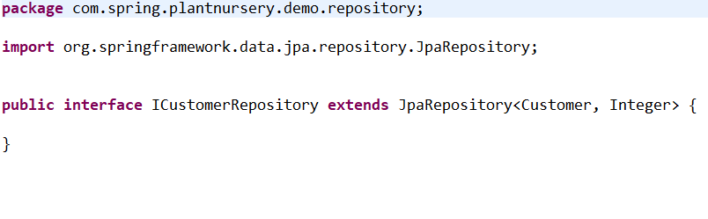
Model of a Repository Class in Eclipse:

Slide 20
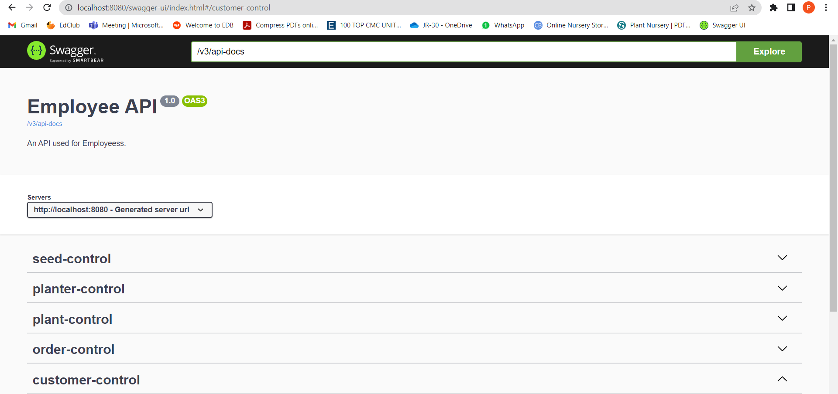
Implementation in Swagger UI

Slide 21
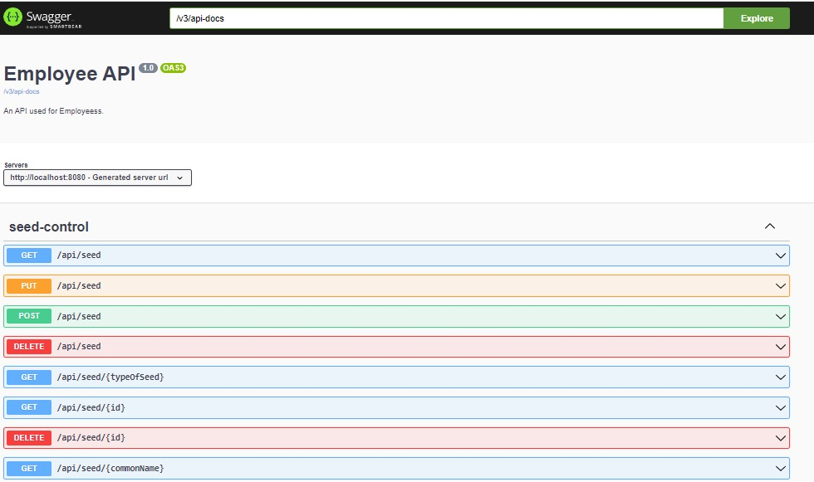
Model of a Module in Swagger UI:

Slide 22
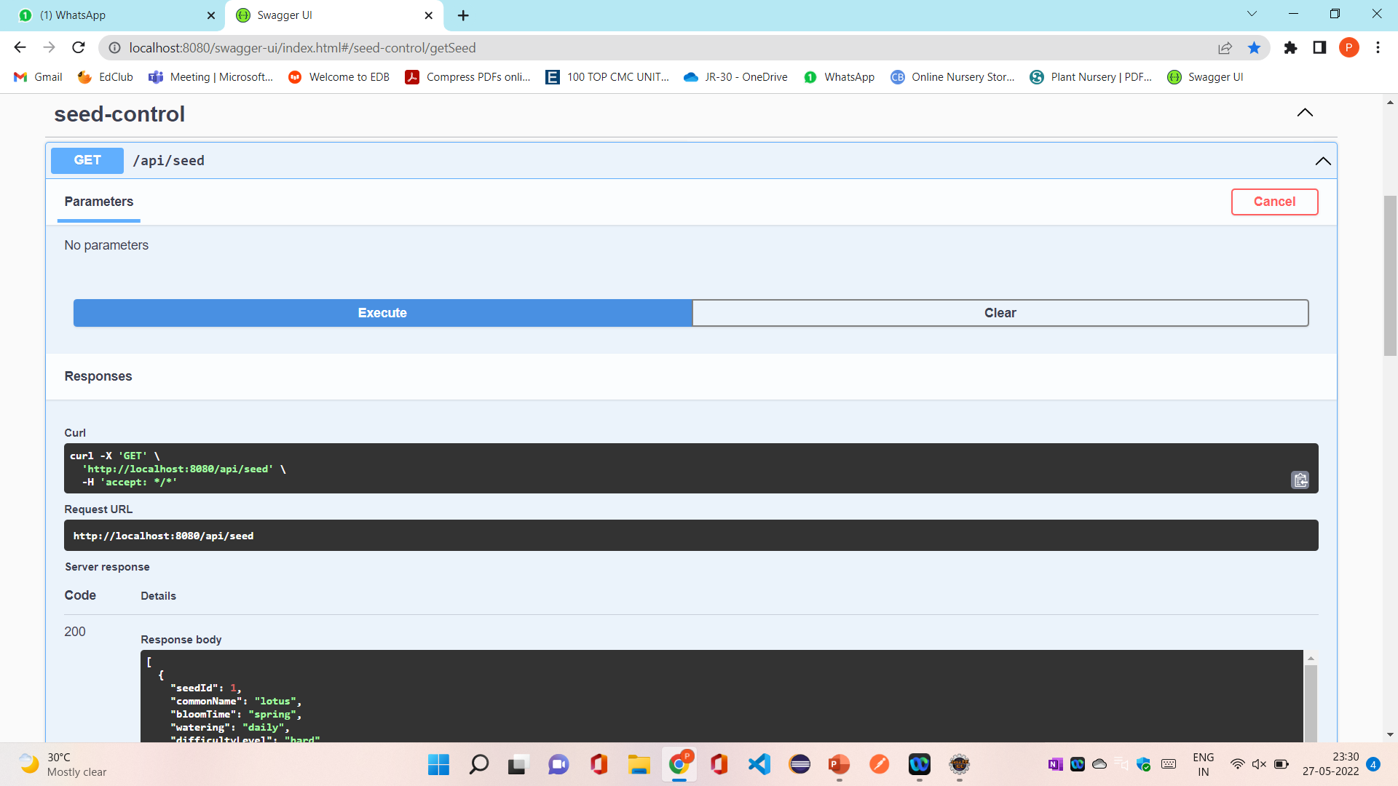
GET:

Slide 23
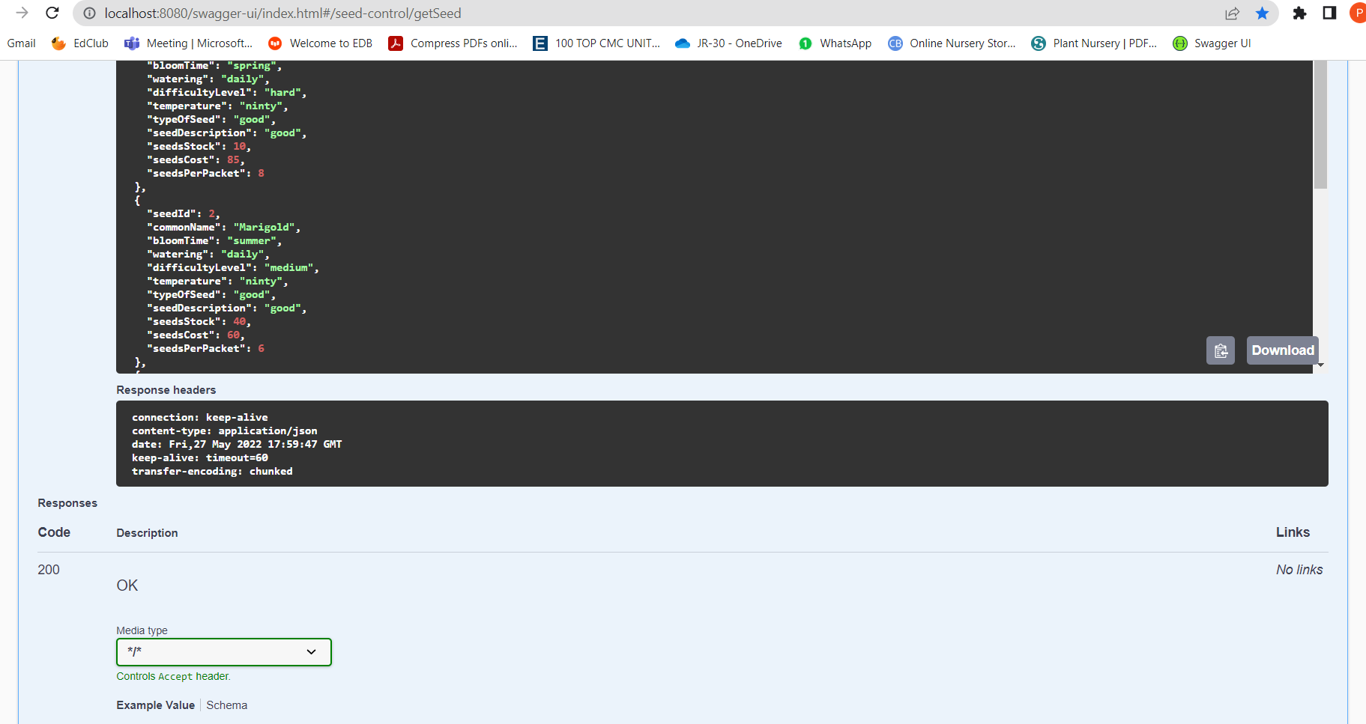

Slide 24
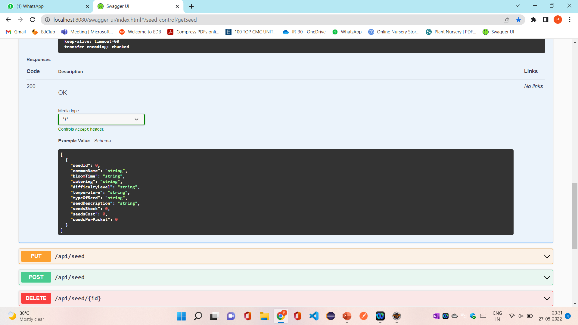

Slide 25
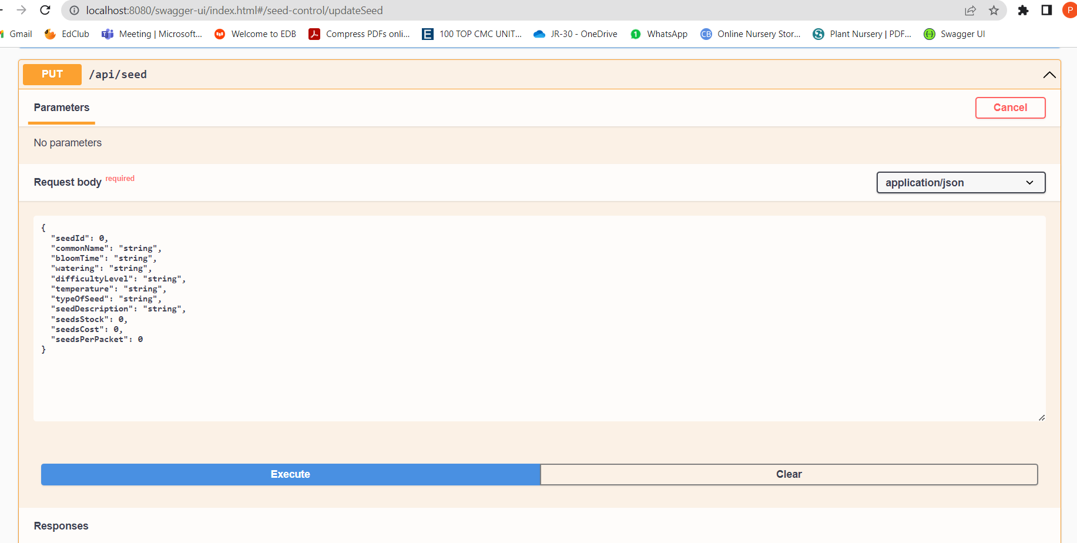
PUT:

Slide 26
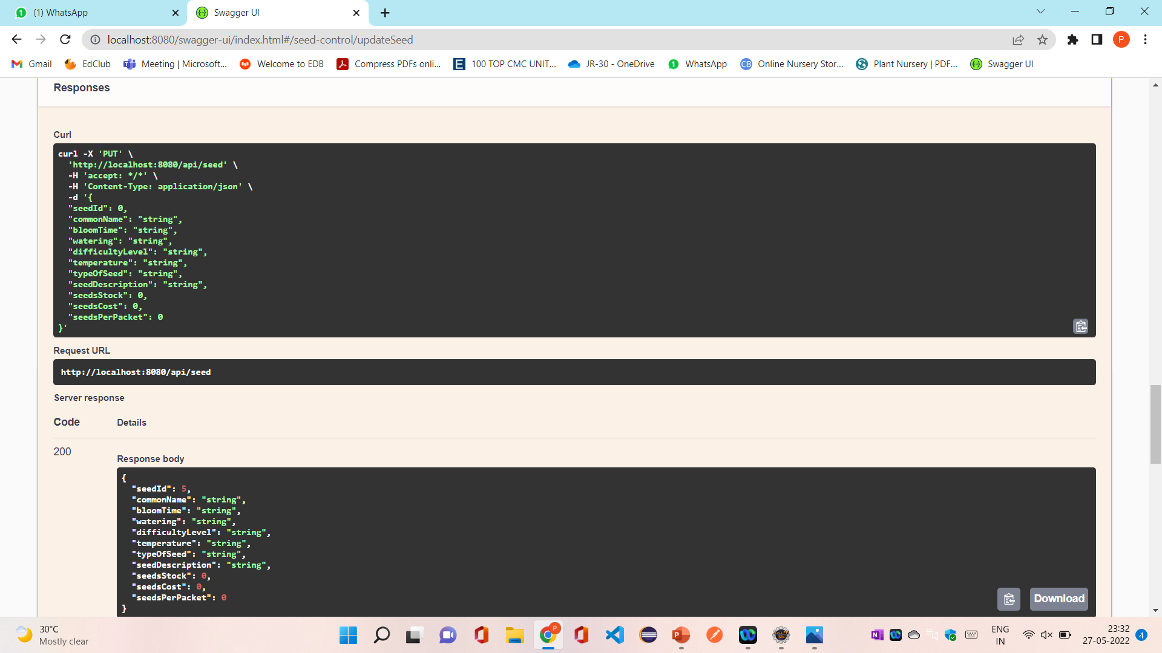

Slide 27
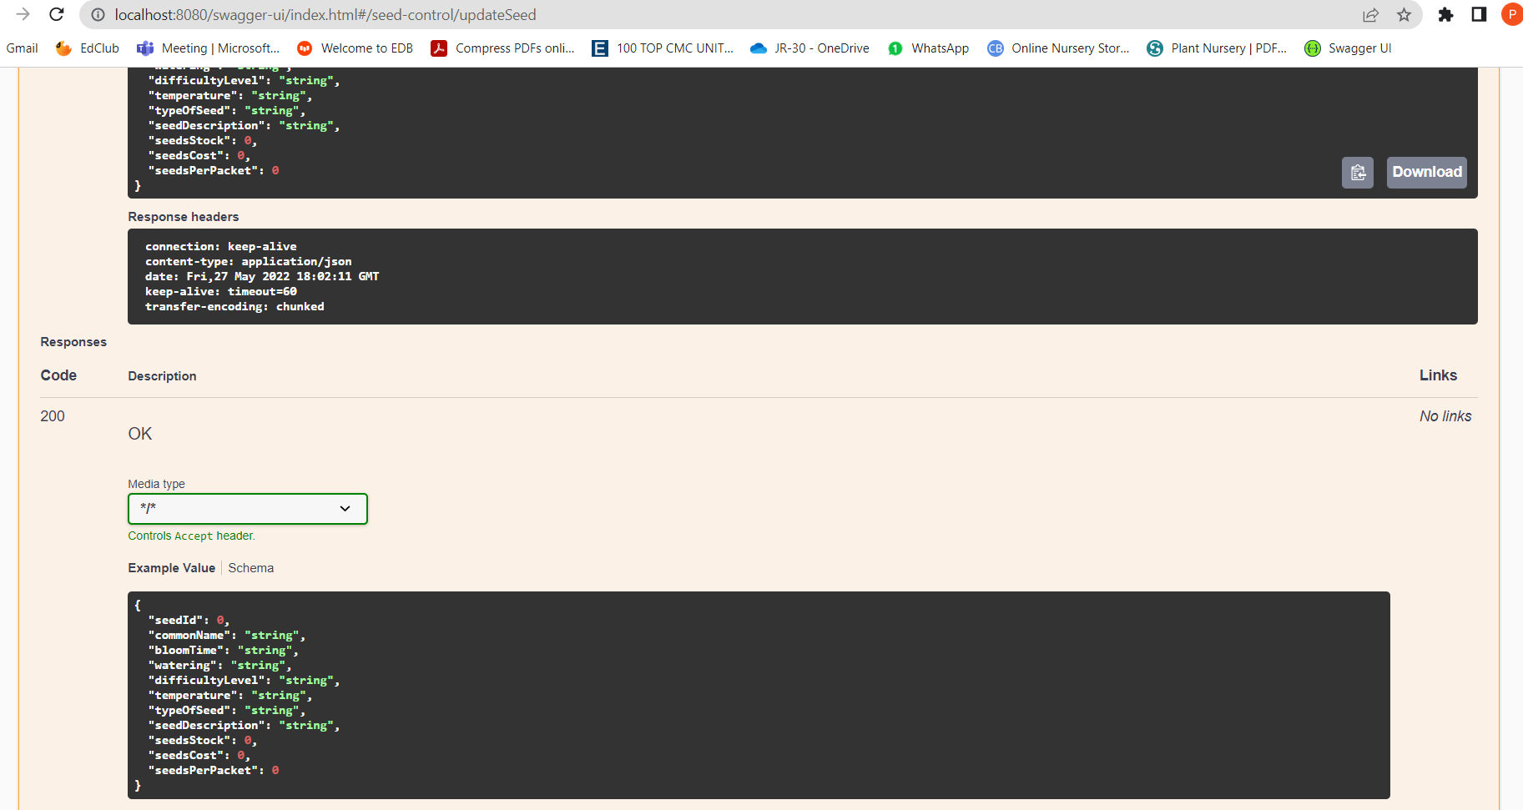

Slide 28
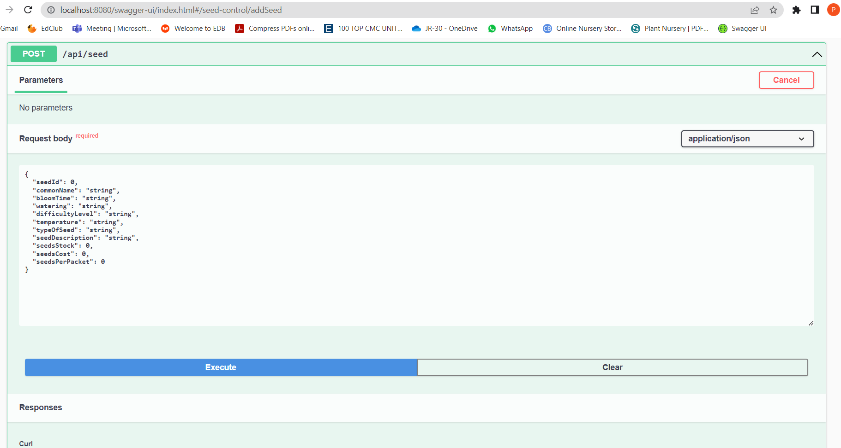
POST:

Slide 29
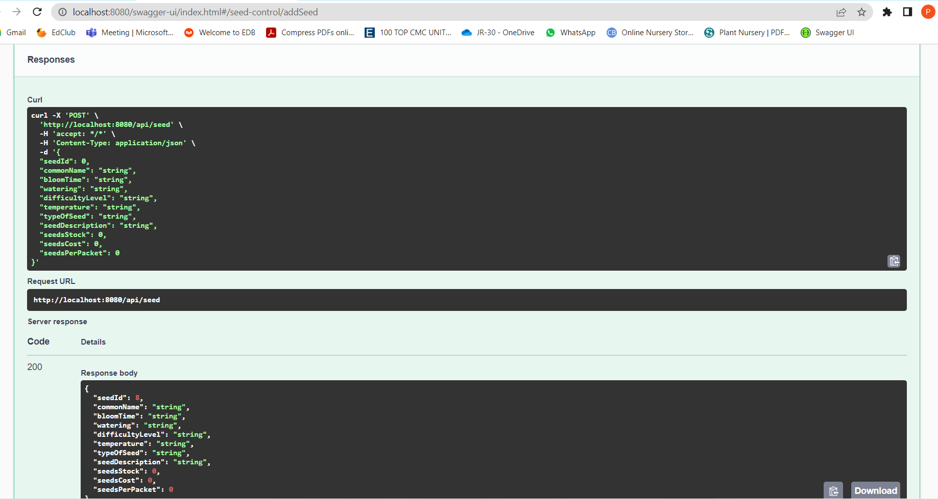

Slide 30
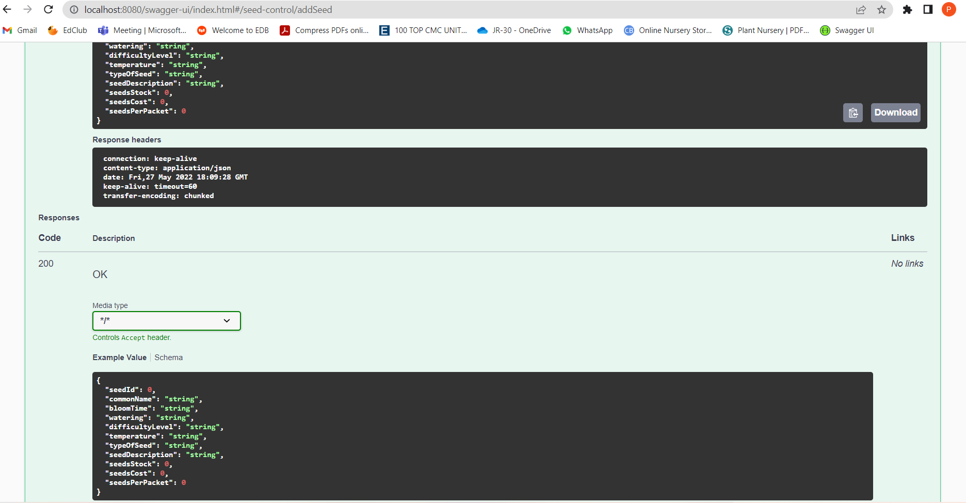

Slide 31
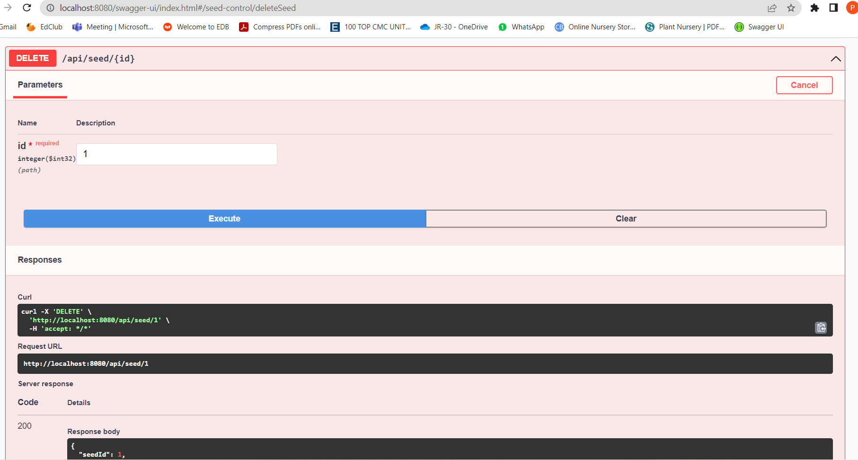
DELETE:

Slide 32
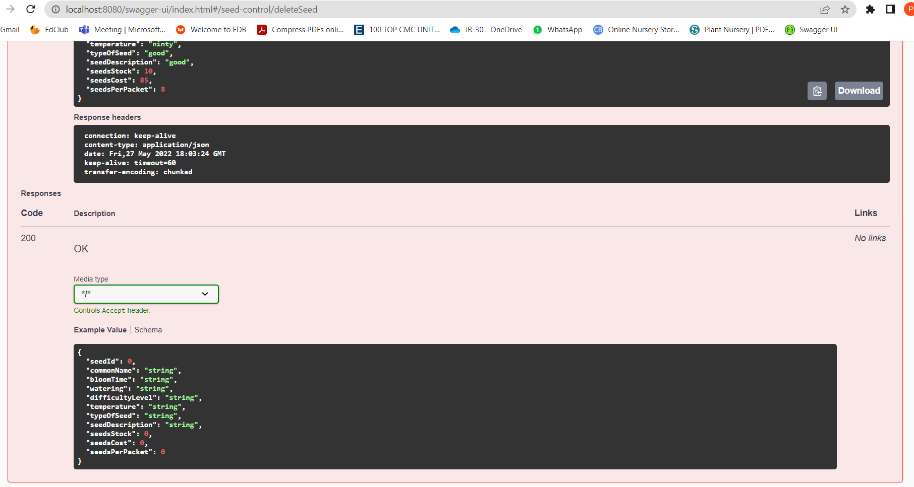

Slide 33
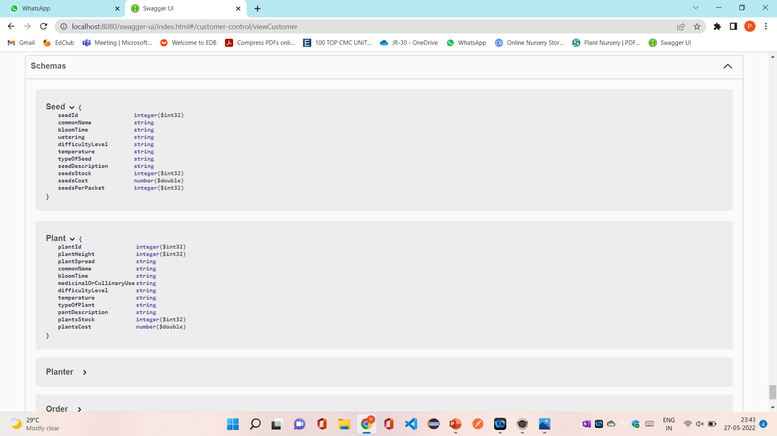
Schemas:

Slide 34
BENIFITS
Being able to buy anytime, anywhere, any place.
Site enables them to browse before they shop, and to research the product so they have more confidence in what they are buying.
Even though online shopping sites are having affordable rates, the offers and discounts will further reduce the cost of the indoor plants.

Slide 35
CONCLUSION
A nursery is a place where plants are spread and grown to usable size.
By using online plant nursery application some retail and wholesale nurseries can be sold by means of E-business.
The proposed system can guarantee to keep the records are safe and privacy which is stored in the database.
It converts unstructured data into structured data and sorted format.

Slide 36


